Slide 1
Investment Banking Division
ANZ Brown Bag
28th May 2013

Slide 2
What we’ll cover
Overview of banking and where it fits into the firm
What Banking does
Objectives and challenges
Deal process
Applications and technologies used

Slide 3
Who We Are
Clients Seeking Capital
Goldman Sachs
Investors with Capital
PUBLIC COMPANIES
CORPORATE ADVISORY
SECURITIES
INSTITUTIONAL INVESTORS
Industry Group
FICC
Financing Group
Equities Product Group
PRIVATE COMPANIES
PRINCIPAL
INVESTMENT
AREA
ASSET MANAGEMENT
RETAIL INVESTORS
GOVERNMENTS
& AGENCIES
GOVERNMENTS
& AGENCIES
GLOBAL INVESTMENT RESEARCH
EXECUTIVE OFFICE
FEDERATION
Operations, IT,
Risk, Controllers
HCM
Legal &
Compliance
Chinese Wall
Who We Are

Slide 4
Who We Are – Business Structure
Industry Coverage
Head of IBD
:
Christian Johnston
Corporate Advisory Division
Head of FG
:
Anthony Miller
Co
-
Chairm
e
n
,
IBD
:
Chris Baohm
/
Tim Burroughs
/
Australia
Alastair Lucas
Product Group
&
New Zealand
COO
:
Dion Werbeloff
Business Manager
:
Sybille Haegler
Financing Group
Capital
Products Group
Real Estate
Natural
Industrials
Financial
New
Equity
Capital
Markets
&
Resources
Institutions
Zealand
Consumer & Retail
Healthcare
TMTG
Restructuring
M
&
A
Group
IBS
Who We Are – Business Structure

Slide 5
What We Do In Our Business
Corporate Advisory – M&A
Financial and strategic advice to large corporations and governments
Products include:
Buy / sell-side advisory, including divestitures and spin-offs
Anti-raid (takeover defence) advisory
Corporate restructurings
Corporate Advisory – Financing Group: ECM & CPG
Capital raisings (public offerings and private placements) including:
Debt and hybrid instruments
Equity and equity-related instruments
IPOs
(Leveraged) Acquisition financing – private equity financing

Slide 6
Objectives and Challenges
Continue to add value to the firm through
Revenue contribution
Cross-selling to other divisions
Building brand awareness
Focus on client relationships
Be the leading Corporate Advisory Group in Australia / NZ (major competitors: UBS and Macquarie)
Requires best team
Navigate through difficult conditions
Volatile markets and low financing volumes

Slide 7










GS in the Market – Lead Adviser on the Largest Deals
Telstra / Optus Negotiations
Bonds
Sale to Foxtel
Restructuring and Divestiture
Privatisation of Desalination Plant
US$7.8bn
US$4.0bn
US$2.7bn
US$2.4bn+
(Pending)
US$2.3bn
Merger with Aston Resources
Takeover Defence
Convertible Bonds and Entitlement Offer
IPO
Sale of Nixon brand
US$2.2bn
US$918m
US$435m
US$432m
US$324m
GS in the Market – Lead Adviser on the Largest Deals

Slide 8
Our Market Positioning – CY2012
Strong Competitive Position – #2 in announced and #1 in completed M&A
M&A – Announced
M&A – Completed
Equity
International Public Bonds
Our Market Positioning - CY2012

Slide 9
Summary
Corporate Advisory comprising of M&A and Financing Group (ECM & CPG)
Split into industry groups and product groups (M&A / FG)
Advising on and executing large corporate transactions and capital raisings
Be the leading Investment Bank in the market
Challenge of current uncertain market conditions, volatile markets and low M&A and financing volumes

Slide 10
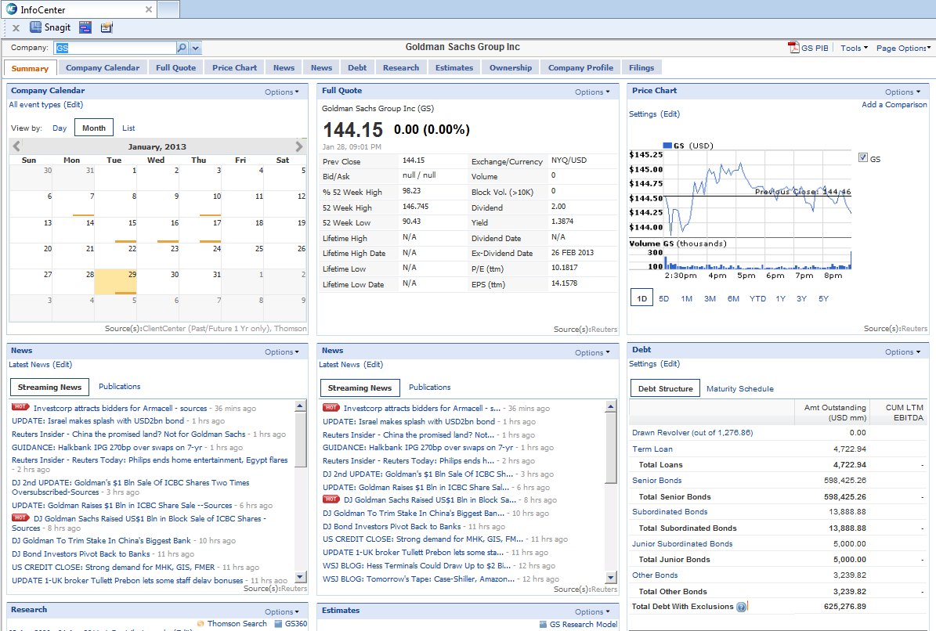
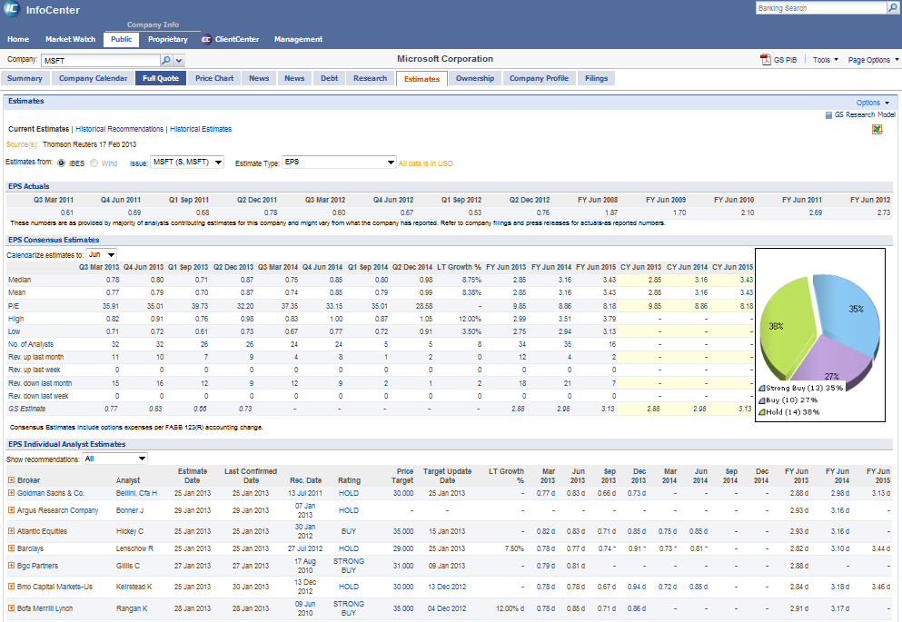
InfoCenter
Market Data and Proprietary Information
What Is It?
InfoCenter is the IBD “one-stop-shop” portal for Market Data, News, Client Meetings, Projects and other Goldman Sachs proprietary information. With fully customizable pages and synchronization with a Blackberry version, this is the place to be.
Highlights
Easily create company watchlists and filter news and market data for those companies.
Receive email alerts for a watchlist of specific company. Available alerts include News Alerts, CDS spreads, Commodities, Refinancing.
Full integration with Excel enabling you to download estimates data, price charts and much more.
Access to company event calendar, research, filings and debt data.
Full access to proprietary data for a particular company – Client Team, Relationship status, contacts, Deals (internal and on the street).
Access to meeting summaries for companies that come under your coverage.
Section Title

Slide 11
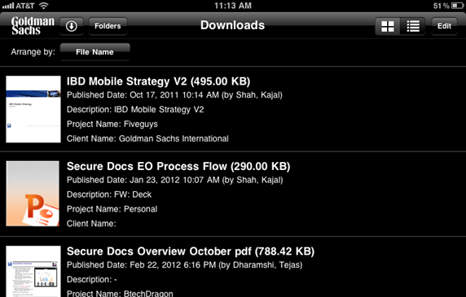
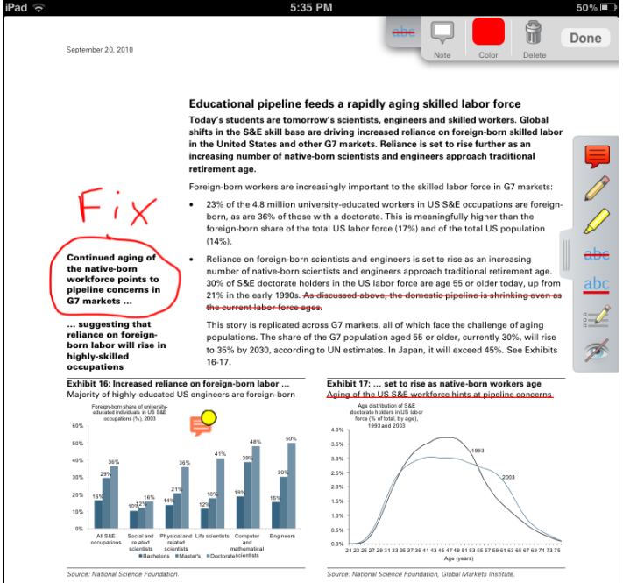
Secure Docs
View Documents On The Road, Anytime, Anywhere
What Is It?
Secure Docs is an iPad application enabling you to view and annotate documents while you are away from your desk without having to be connected to the Goldman Sachs network. Once you have completed any annotations, you can save back to a project share for other members of your team to review.
Highlights
Publish documents to Secure Docs via email or InfoCenter.
Downloaded documents are protected by secure container technology.
Documents are deleted are 30 days as per compliance requirements.
Annotation functionality includes – highlighting, strikethroughs, freehand style, typing in comments and much more.
Section Title

Slide 12
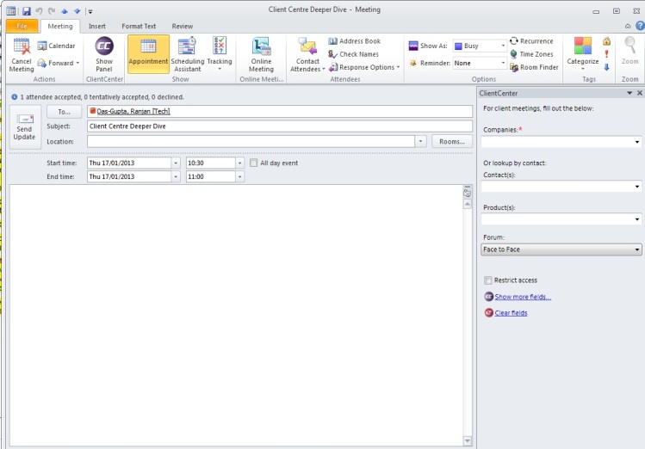
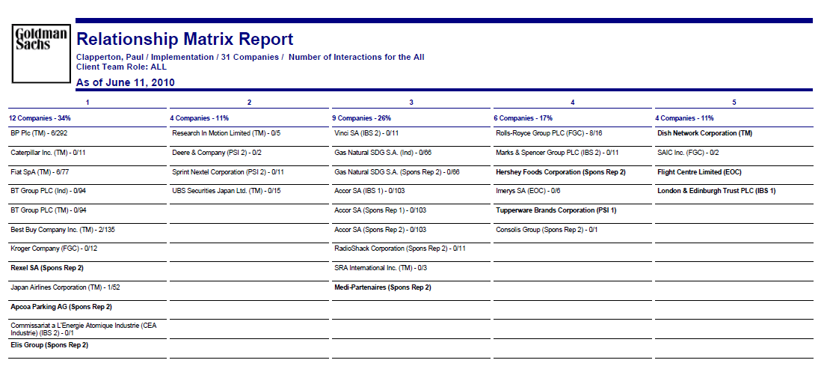
ClientCenter
Efficiently Capture Client Interactions / Opportunities
What Is It? ClientCenter is the IBD Client Relationship Management tool & is integrated with Outlook, InfoCenter, and your Blackberry, so that interactions can be efficiently captured and securely shared with client team members, business unit leaders and managers.
Highlights
Receive pre-meeting emails with the latest news, market data and recent meeting summaries on the company that you’re meeting.
Receive a weekly email summarizing recent and upcoming meetings for clients that call within the industries and regions you cover, including financing opportunities for your products(s) that were entered by IBS reps or FG teams.
Full integrated - enter meeting interactions into ClientCenter from Outlook, InfoCenter or your BlackBerry.
Tight security around who can see meetings and summaries as specified by the business. Fully engrained within Business Reporting.
Section Title

Slide 13
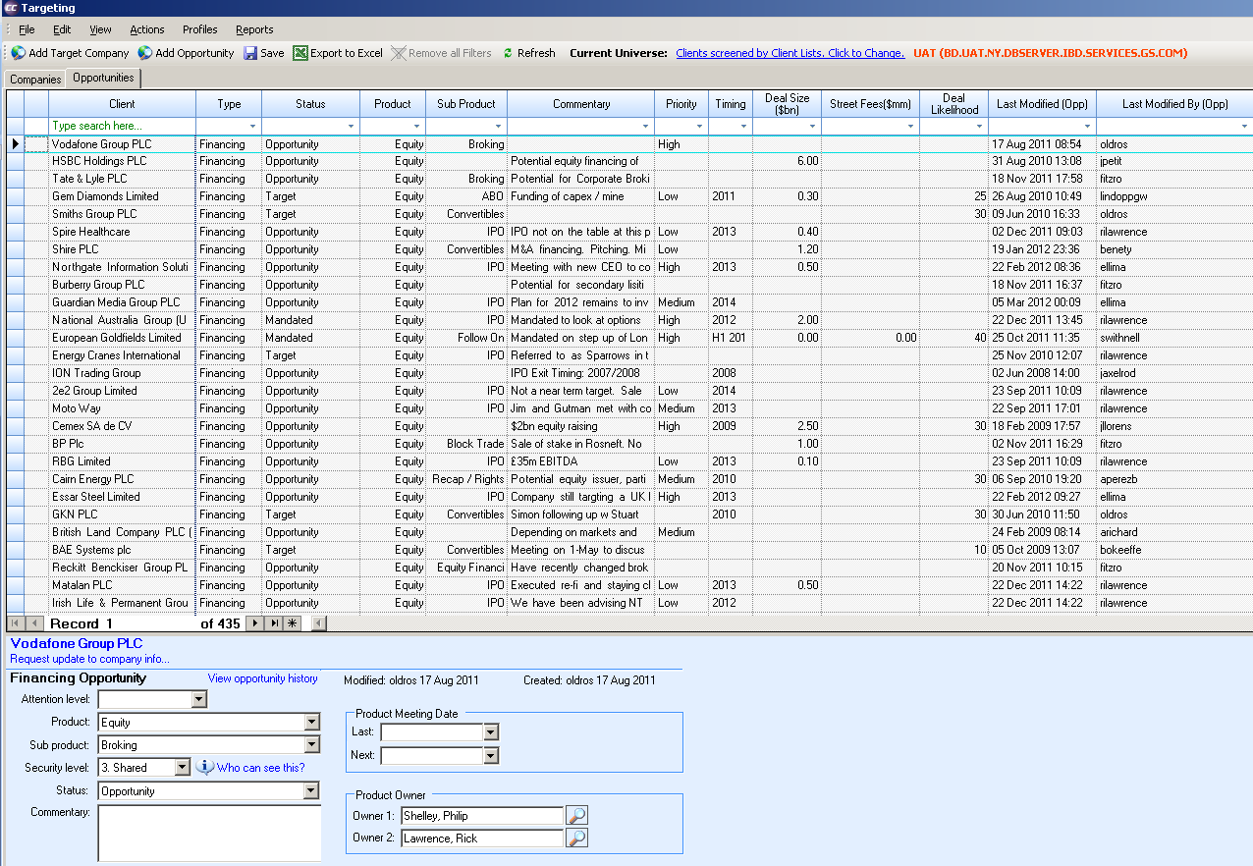
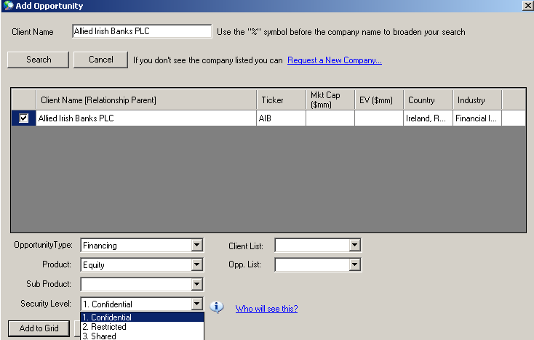
Targeting Tool
Efficiently Capture Future Business
What Is It? An Excel-like tool that empowers senior management to quickly answer the following questions: Which business opportunities are my teams currently perusing and how close are they to winning the mandate?, Which deals require some influence from me?, Which mandates are currently on hold? (e.g. change in client sentiment due to market conditions). The tool enables BUMs, CFOs, BULs and IBD Management to track their backlog from a single system & generate reports.
Highlights
Allows bankers to report their targets and opportunities to management from a single system.
Easily enter new or update opportunities in InfoCenter or Mobile InfoCenter.
Lists opportunities for clients, including timing, deal likelihood and deal size.
Section Title

Slide 14
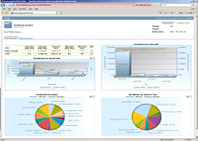
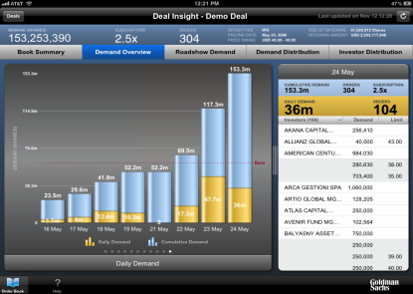
GS PIB
Fast & Efficient Way of Creating Public Information Books
What Is It? Available through InfoCenter, you can easily create public company information booklets and even send directly to Secure Docs. Easily add a GS tear sheet, Company Profiles, News, Estimates, Ownership, Research, Deals, Filings and Corporate Events.
Highlights
Add “Custom Files” such as previous pitch books to PIBs.
Send for review with others before creating the book.
Section Title

Slide 15
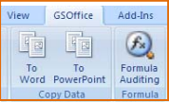
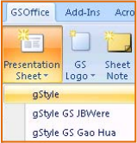
GS Office
Fast & Efficient Way of Creating Public Information Books
What Is It? A range of extensions, macros and stylesheets for MS Office application which help to make life easier for regular tasks performed by bankers
Highlights
SecDB integration with Excel for data lookups
Divisional stylesheet support
Formula auditing to trace dependencies even across workbooks
Standard slide layouts and creation wizards
Integration with ClientCenter / InfoCenter
Section Title

Slide 16
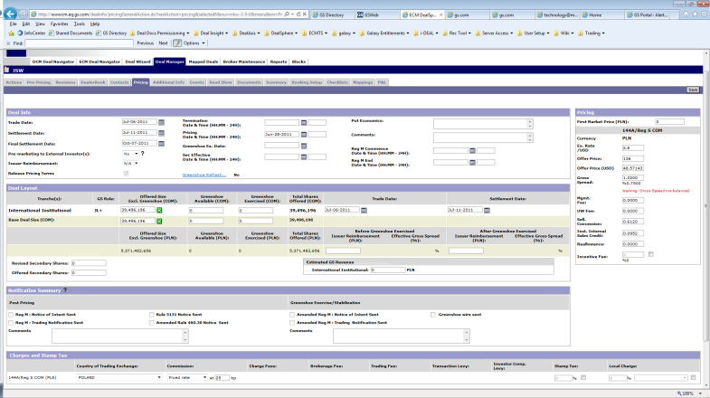
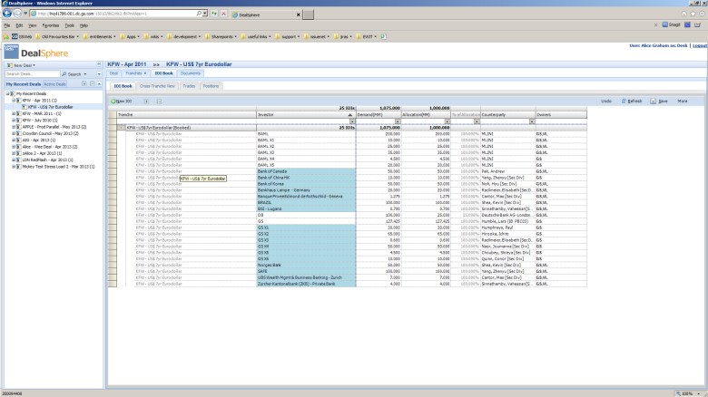
DealSphere / DealSphere2
Equity and Debt Bookbuilding systems
What Is It? DealSphere and DealSphere 2 are the primary platforms used by the Financing Group to manage the bookbuilding process for equity and debt deals.
Highlights
Integrates directly with Ideal/Ideal2 to receive orders from Sales
Integrates with DealAxis/IssueNet – street-wide hubs for sharing deal and order information
DealSphere2 supports Automatic trade booking of both the trading and sales side of the trade
Robust permissioning allowing read-only access to controllers and other IBD users who have an interest in the deal

Slide 17
DealInsight On The iPad
Live View Of Order / Allocation Book
What Is It? GS branded external portal presence for issuers and internal deal teams. Live view of the order / allocation book with ability to slice / dice data. Charting & Analytics functionality to view demand / allocation by region, investor type and limits. Connectivity with Brokers to manage joint-books (DCM). Available on mobile devices.
Highlights
Available Charts & Analytics: Demand overview by hour / day / week, Roadshow event information including whether orders have been placed by attendees to those events, Also includes demand distribution by pricing points, and Investor Distribution by type, region & roadshow.
Section Title

Slide 18
Questions

